Slide 1
APUSH Review: Tammany Hall and “Boss” Tweed
Everything You Need To Know About Political Machines and “Boss” Tweed To Succeed In APUSH

Slide 2
Background Info on Tammany Hall
Tammany Hall was established in the late 18th century
Influential in the election of 1800
What was it?
It was a “Political Machine”
Organization that held tremendous influence in NYC
Encouraged the public to vote for Tammany “men”
Rewarded voters with patronage
Rewarded voters with patronage
Many mayors of NYC, and even governors of NY were Tammany “men”
Held tremendous influence throughout the 19th and early 20th centuries

Slide 3
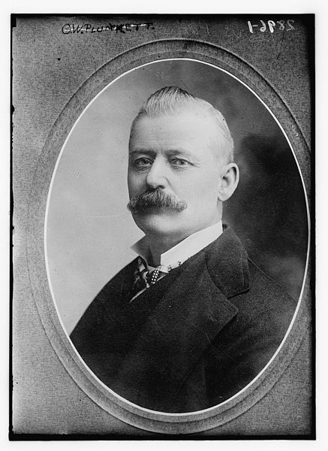
Graft
What is graft?
Using political power for a personal gain
“Honest Graft”
Using inside information for personal gain
George Washington Plunkitt
“Dishonest Graft”
Stealing, bribery, etc.
William “Boss” Tweed
There's an honest graft, and I'm an example of how it works. I might sum up the whole thing by sayin': "I seen my opportunities and I took 'em."
Just let me explain by examples. My party's in power in the city, and it's goin' to undertake a lot of public improvements. Well, I'm tipped off, say, that they're going to layout a new park at a certain place. I see my opportunity and I take it. I go to that place and I buy up all the land I can in the neighborhood. Then the board of this or that makes its plan public, and there is a rush to get my land, which nobody cared particular for before. Ain't it perfectly honest to charge a good price and make a profit on my investment and foresight? Of course, it is. Well, that's honest graft.

Slide 4
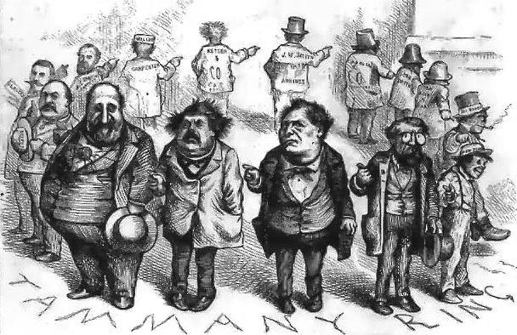
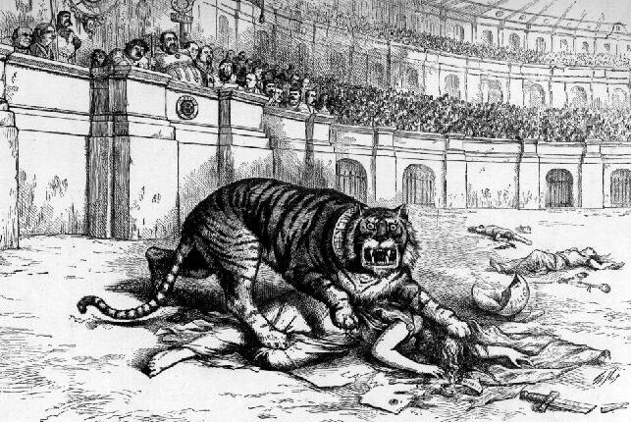
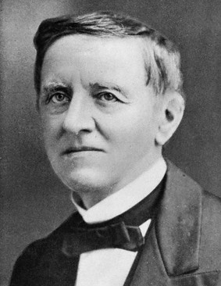
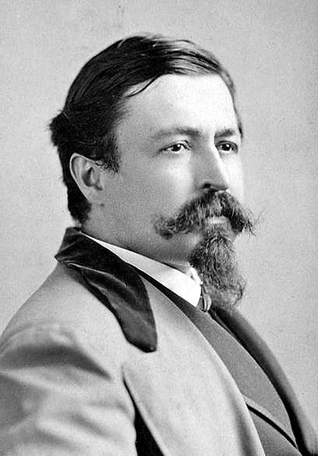
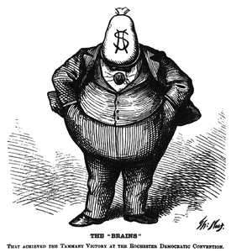
William “Boss” Tweed
Most famous member of Tammany Hall
“Tweed Ring”
Stole up to $200 million from NYC
High contracts for friends and workers
Thomas Nast
Influential political cartoonist
Staunch critic of Tweed and Tammany Hall
Samuel Tilden
Played a key role in Tweed’s downfall
Helps catapult him to the Democratic nomination in 1876 (Compromise of 1877)

Slide 5
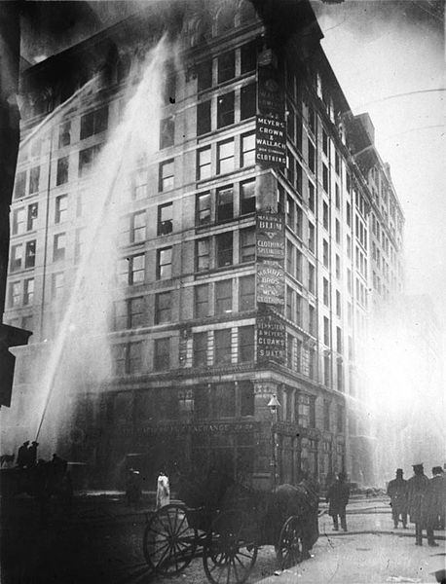
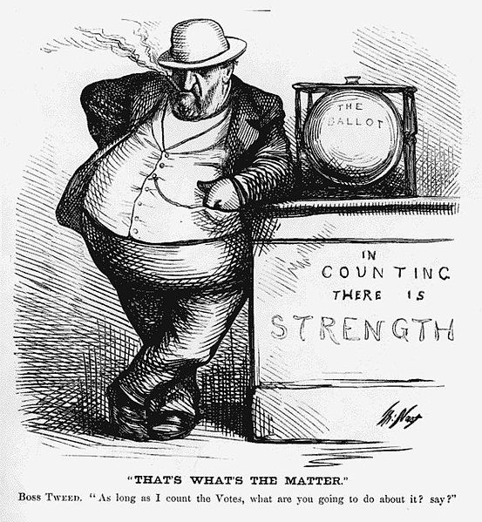
Tammany Hall in the early 20th Century
Triangle Shirtwaist Factory Fire
March 25, 1911
Worst workplace disaster in NYC history until 9/11
100+ workers (mostly women) died
Tammany Hall played an instrumental role in new workplace laws
Progressive political changes like the secret ballot weakened the influence of political machines
By the 1960s, Tammany was no longer in power

Slide 6
Test Tips
Essay Topics:
Not likely on Tammany Hall itself
Rather, it could be included into politics during The “Gilded Age”
Tips for Multiple-Choice questions:
Be familiar with political cartoons and Boss Tweed
Don’t sleep on Thomas Nast
Be able to identify the Triangle Shirtwaist Factory fire as well
Good Luck!

Slide 7
Thanks for watching!
Subscribe to my channel
Help spread the word
Questions? Comments?
Leave in comments
I want you to subscribe!
Subscribe
Down here!
subscribing

